Slide 1
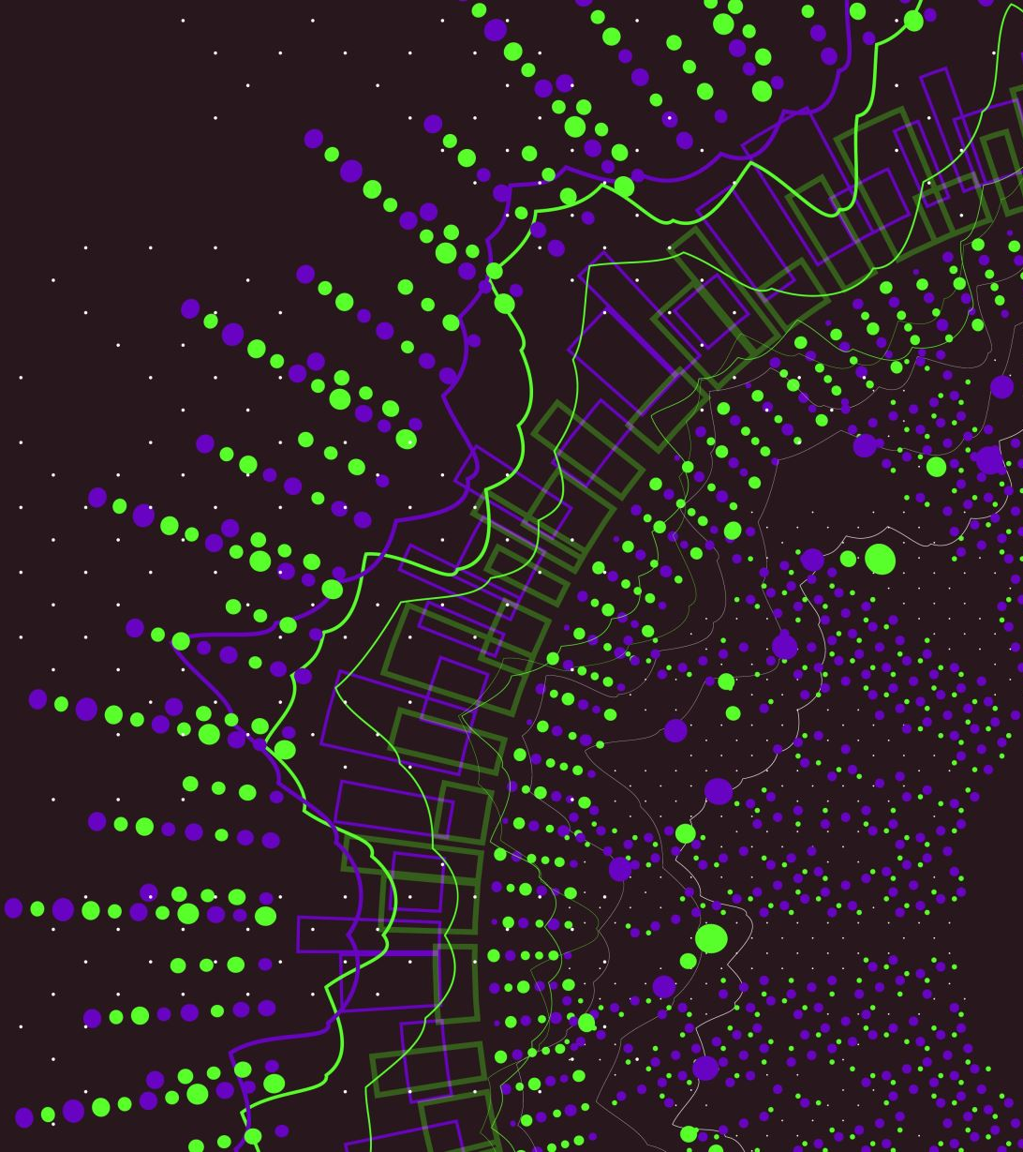
ABM for Marketing Research
Model version 2

Slide 2
What happened in Model version 1 (Model Build)
In Consumer (Agent) class:
Define the attributes of agent: influencer or not, innovator or not
Adopted or not
Use step to observe the change of opinions of an agent
(Innovator: ‘p’, Imitator: ‘q’)
In Bass Model (Model) class:
Define the value of p and q, N stands for the number of agents
Proportion for the influencer and innovator
Define the network type: small world or random network

Slide 3
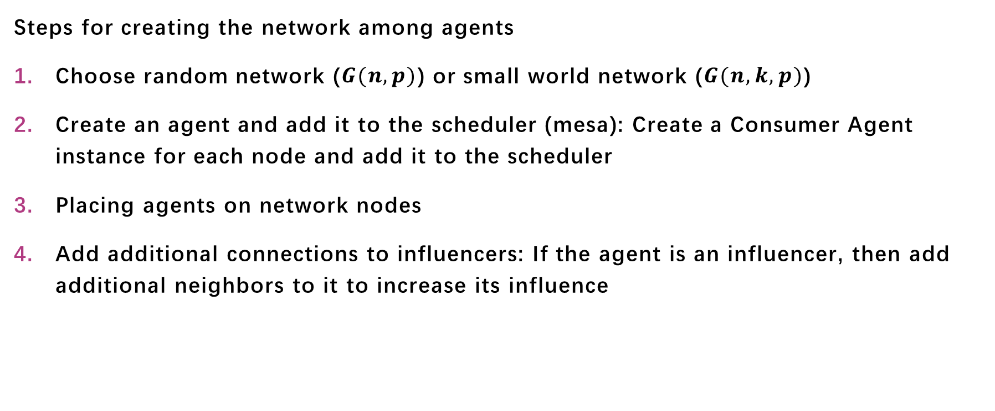
What happened in Model version 1 (Init network)
Steps for creating the network among agents
Choose random network ($G(n,p)$) or small world network ($G(n,k,p)$)
Create an agent and add it to the scheduler (mesa): Create a Consumer Agent instance for each node and add it to the scheduler
Placing agents on network nodes
Add additional connections to influencers: If the agent is an influencer, then add additional neighbors to it to increase its influence

Slide 4
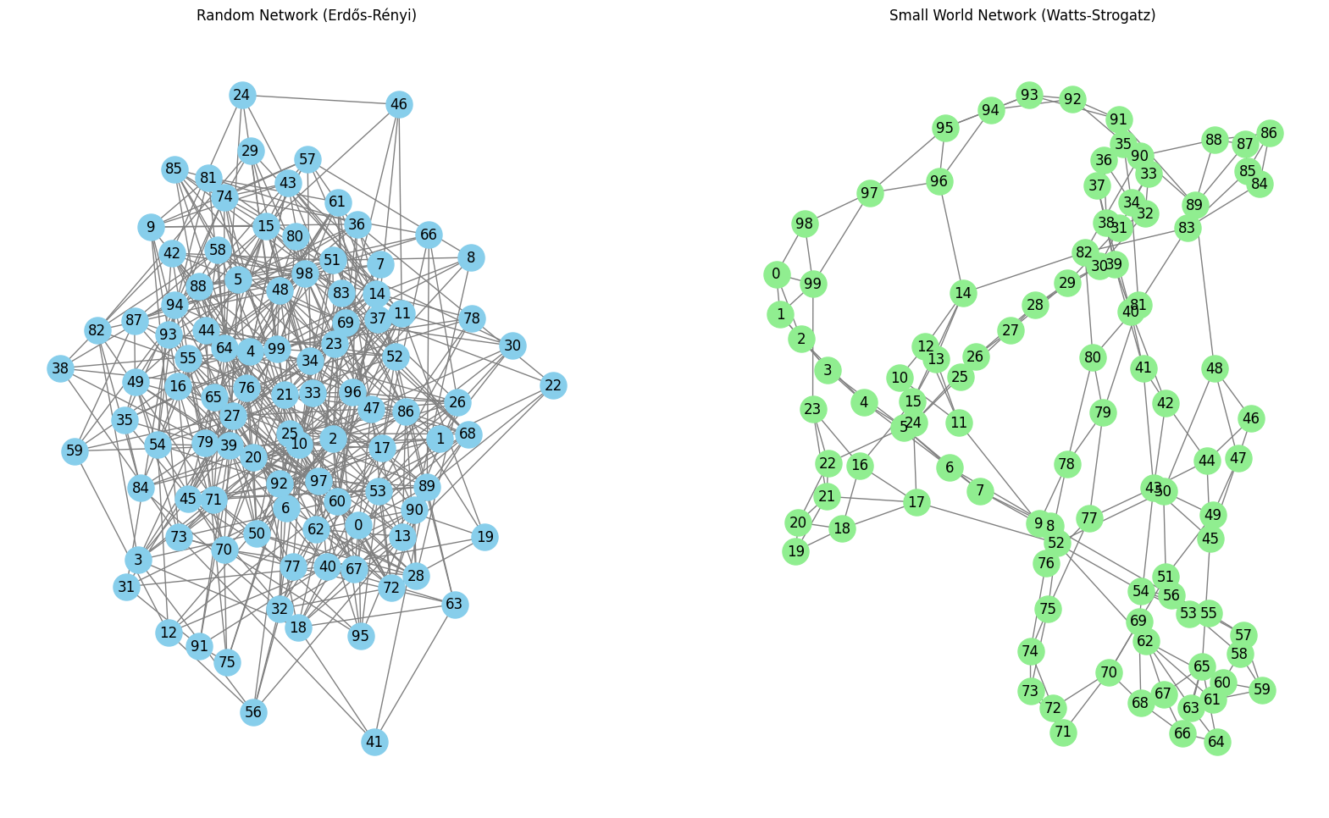
Random Network or Small World Network?

Slide 5
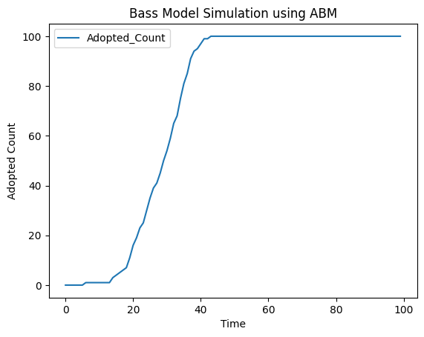
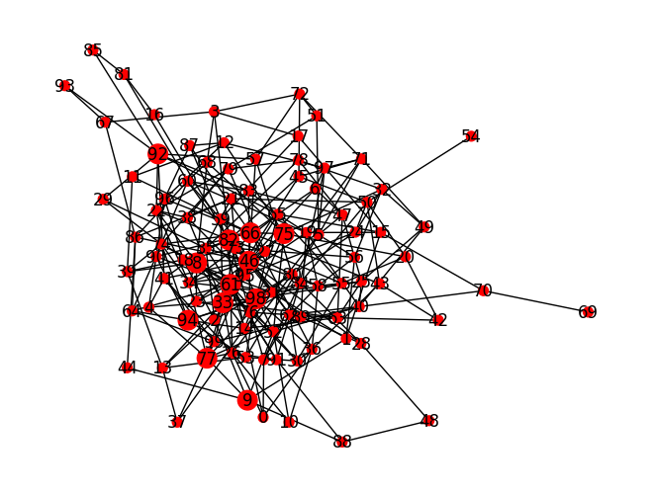
What happened in Model version 1 (Visualization)
Show the Adopters’ number of the consumers
Show the Adopters’ network
(red stands for accepted)

Slide 6
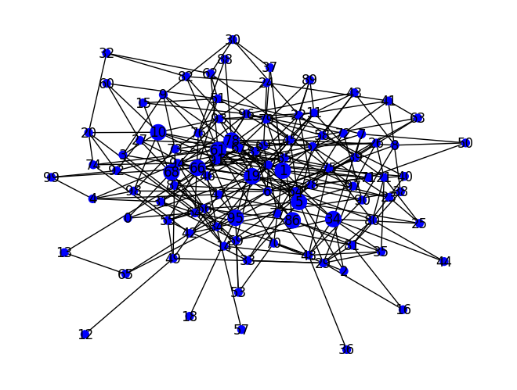
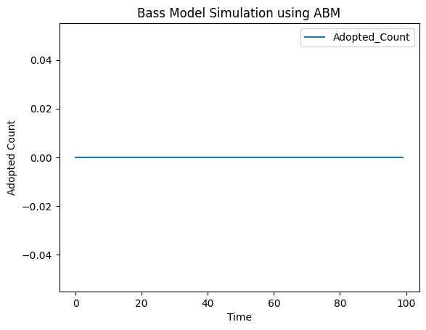
Bugs Encountering (no adopter)
When the setting time arrives, there is a certain possibility that no agent becomes adopted.

Slide 7
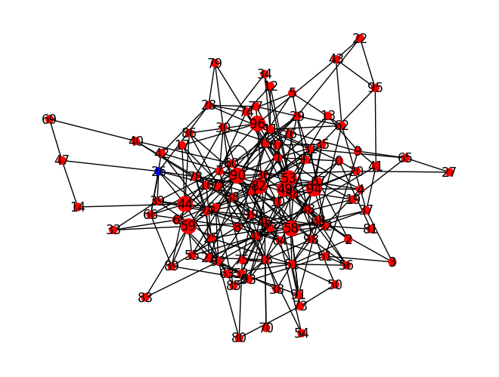
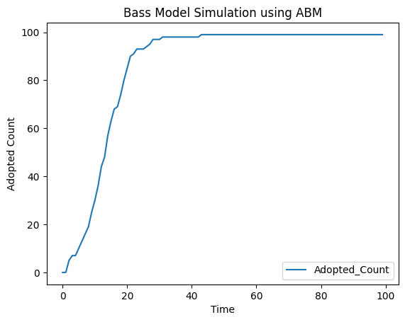
Bugs Encountering (self-connected)
When adding new connections to influencers, there is a certain possibility that they will connect themselves and form a loop.

Slide 8
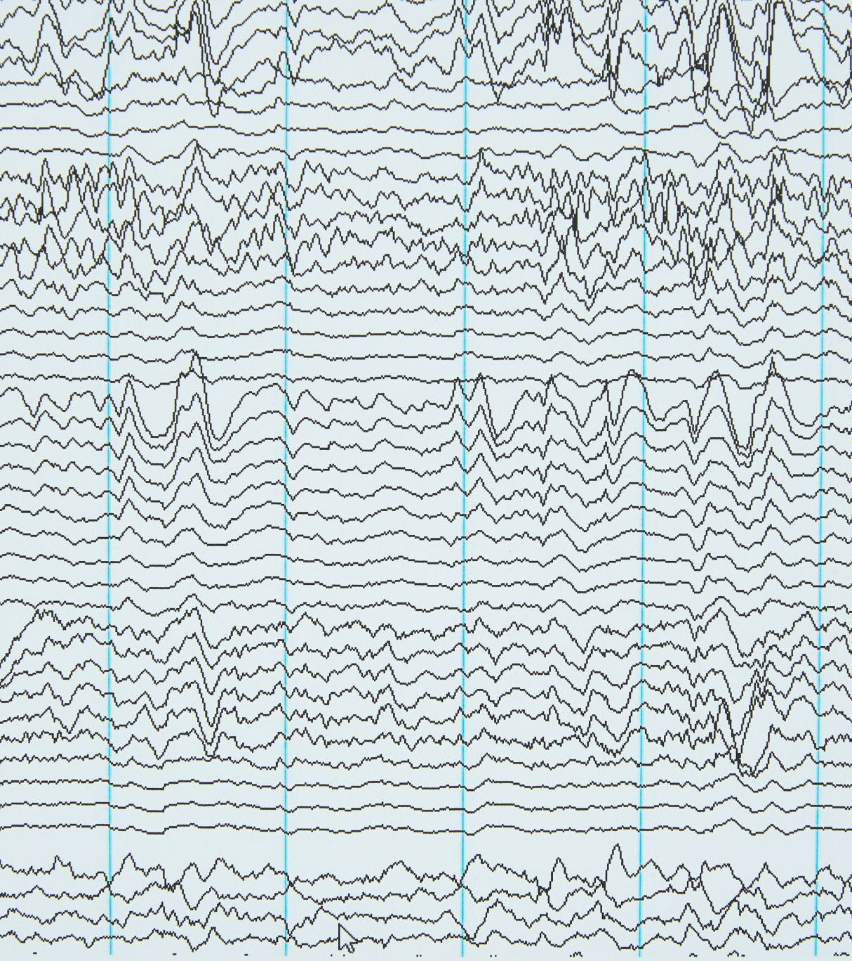
In the next model: ABM version 2
Add some statistical indicators, for example:
At time step T, the number of accepted agents reached 25%, 50%, 75% and 100%.
When drawing the acceptance curve of users, I will separate the influencers and innovators into multiple curves to observe their changes.
Batch Running:
The effect of a single model run is accidental, so models with the same parameters can be run in batches and then the average of their results is calculated.

Slide 9

Topics to discuss
Whether other data science methods need to be added to the model and compare the results. (like linear regression or causal inference)
Any statistical test in ABM like p-value or...
I'm looking for is there a possibility to add new parameters to the model.
I think the research goal of this topic can be discussed, which is to find the optimal parameters, such as p, q, and the ratio of innovators and influencers. When time is limited, a certain number of recipients must be reached before a certain moment.

